Slide 1

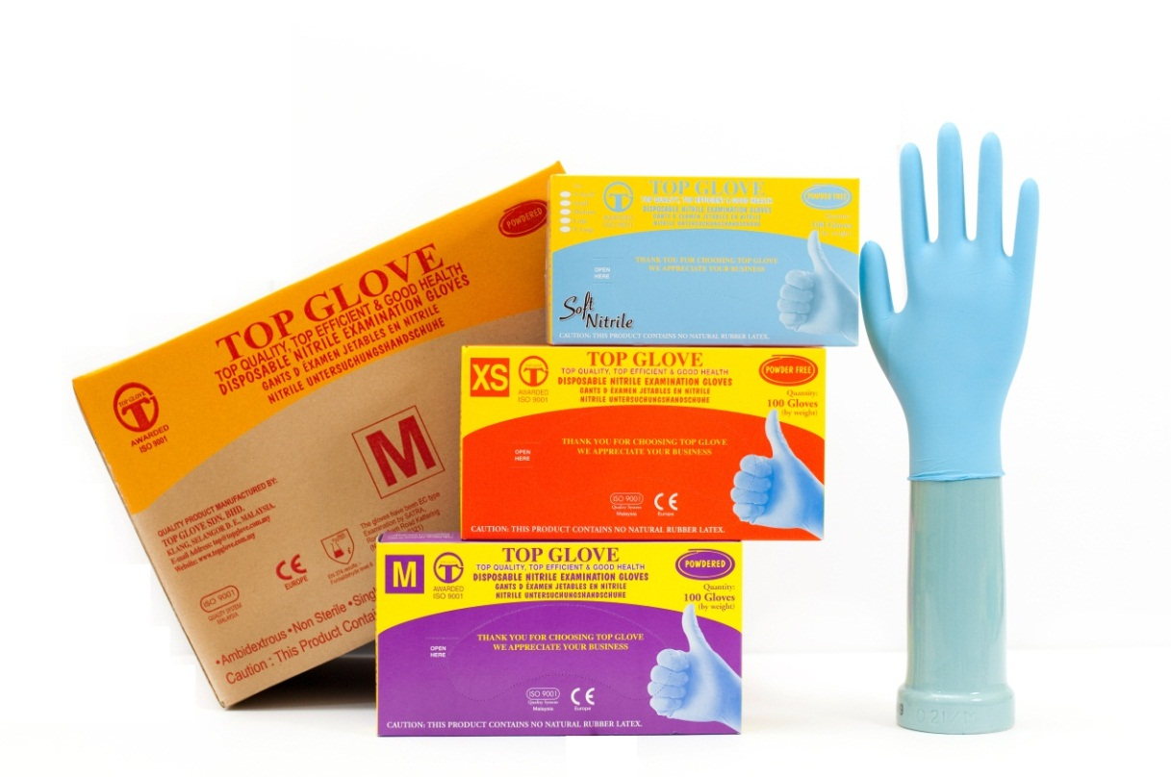
The World’s Largest Rubber Glove Manufacturer
Top Glove Corporation Bhd
Top Glove, Top Quality, Top Efficiency,
Good Health, Safety First, Be Honest
Bursa Malaysia 7113 Reuters TPGC.KL Bloomberg TOPG MK ADR CUSIP 890534100

Slide 2
Top Glove 10 Training Ground Rules
Know the Emergency Exit & Route
Come to training with the END IN MIND
Be PUNCTUAL - in attending the training, coming back from breaks.
Hand phone- Silent / Vibrating Mode
Competition/ debate- Healthy and constructive ones only!
NO side conversation – show respect when others is talking!
NO disruptive feedback please!
Participate actively!
Listen actively! Every feedback from each participants has its value!
Perform HOUSEKEEPING at the end of each day’s training
Notes:
10.00 – 10.05am
-Explain

Slide 3
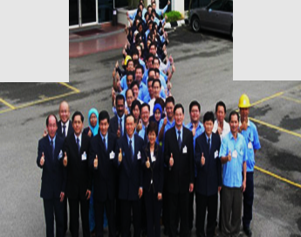
WELCOME TO TOP GLOVE
Congratulations on your employment in TG.
You have now joined a team of more than 10,000 employees, who are dedicated to support TG’s vision & mission.

Slide 4
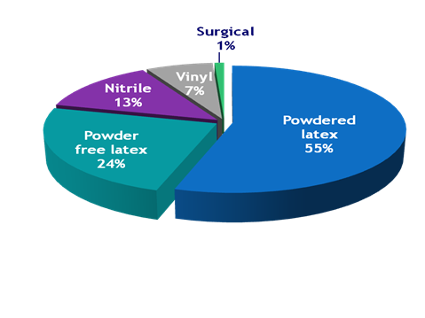
AT A GLANCE…
Commenced operations in 1991 with 3 production lines, TG have grown to being listed in BSKL by 2001
Comprehensive product range with 13 major types of rubber gloves
80% of production for health care sector and 20% for non-health care sector
Produce 80% natural rubber (NR) glove and 20% synthetic rubber glove
Target capacity mix –
50% NR: 50% SR with flexibility to interchange
Customers’ satisfaction is our Company’s main focus. Top Glove is very focused on being a “One Stop Complete Glove Sourcing Center”.

Slide 5
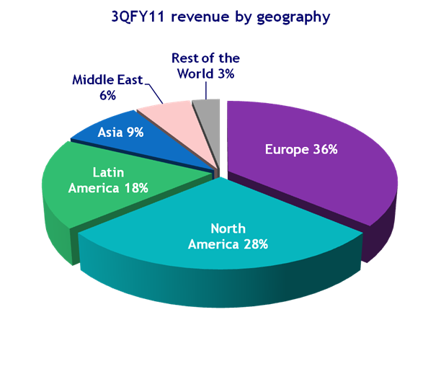
GEOGRAPHICALLY DIVERSIFIED
Exports to 185 countries with more than 1,000 customers
No single biggest customer constitutes more than 4% of revenue
Customers are mainly distributors in the respective countries
Preferred Original Equipment Manufacturer (OEM).

Slide 6
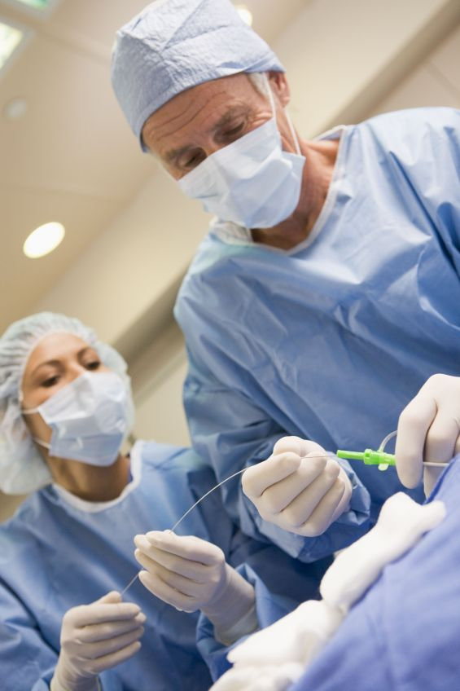
KEY INDUSTRY DRIVERS
1. Medical gloves is a necessity in healthcare industry
As a barrier of protection
2. Increasing healthcare and hygiene awareness
Especially in developing countries
3. Health regulations
Healthcare reforms, eg. US, China
Healthcare regulations eg. OSHA in US, EU-OSHA in Europe, SESI in Brazil
4. Emergence of health threats
E.g. A(H1N1), SARS, bird flu, Bio-terrorism threats, Anthrax

Slide 7

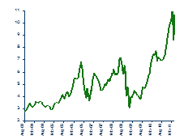
Challenges in glove industry
$
Currency exposure
Majority sales in USD, subject to USD currency movement
Crude oil price fluctuation/ speculation
Impact on energy cost, other raw materials and logistic cost
Inflation
Latex price fluctuation
Due to weather impact, crude oil price movement, speculation

Slide 8
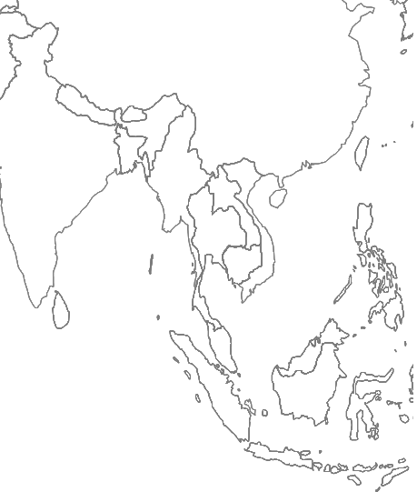



22 manufacturing facilities across 3 countries (as at November 2011)
20 glove factories 35.25 bil capacity p.a. from 395 production lines
2 latex concentrate/ processing plants supply 60% to 70% of Top Glove’s requirement
China 2 glove factories
Produce: Vinyl glove PE glove
Malaysia 16 glove factories
Produce: Latex examination glove Nitrile examination glove Surgical glove Household glove Cleanroom glove
Thailand 2 glove factories 2 latex plants
Produce: Latex examination glove Latex concentrate

Slide 9

SENIOR MANAGEMENT TEAM
Tan Sri Lim Wee Chai
Chairman of Top Glove Corporation Berhad
Founder of Top Glove Group of Companies
Lee Kim Meow
Managing Director
President of Malaysian Rubber Glove Manufacturers’ Association
Puan Sri Tong Siew Bee
Executive Director

Slide 10

SENIOR MANAGEMENT TEAM
Lim Hooi Sin
Executive Director
Founder of TG Medical USA
Lim Cheong Guan
Executive Director
Director of Malaysian Investor Relations Association Berhad (MIRA)

Slide 11
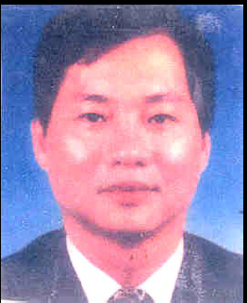
HEAD OF FACTORIES
Wong Chong Ban
General Manager
HOF of F02 / F09 / F11
Philip Thomas
Deputy General Manager
HOF of F3 /F14
Hue Kon Fah
Senior General Manager
HOF of F4 /F12

Slide 12
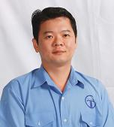

HEAD OF FACTORIES
Nagappen Kumarasamy
General Manager
HOF of F05 /F23
Saw Eng Kooi
Senior Manager
HOF of F06
Chookiad Usaha
General Manager
HOF of F16L / F17L

Slide 13
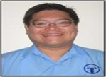
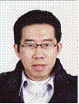
HEAD OF FACTORIES
Yap Kee Cheng
General Manager
HOF of F8
Lew Sin Chiang
General Manager
HOF of F10 / F13 / F21
Tan Chee Hoong
Deputy General Manager
HOF of F15

Slide 14
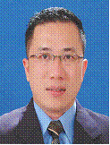
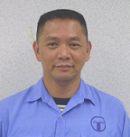
HEAD OF FACTORIES
Lau Heng Chee
Deputy General Manager
HOF of F07
Wu Kin Yeap
Senior General Manager
HOF of F18
Puon Tuck Seng
Deputy General Manager
HOF of F19/ F20

Slide 15
VISION, MISSION, POLICIES & OUR VALUES
VISION
MISSION
CORPORATE VALUES
QUALITY POLICY
We strive to be the world’s leading manufacturer with excellent quality glove products and services that enrich and protect human lives.
To be a world class glove manufacturer providing top quality products with excellent services through continuous improvement and innovation.
Quality and productivity are our business.
Continuous improvement and innovation are our duties.
Towards zero defect is our target
Global customer satisfaction.
Do it right first time and every time
Intergrity and total commitment
Excellence in quality and competitiveness.
Environmental friendly and social responsibility

Slide 16
Corporate culture
Must know. Must do. Must teach.
Business direction To produce consistently high quality gloves at efficient low cost. | Business rules Do not lose our shareholders’ money. Do not lose our health. Do not lose our temper. Do not lose our customers.
Business ethics Honesty Integrity Transparency | Business philosophies We work for our customers. We take care of the interest of our shareholders. We ensure that our employees continue to contribute positively to the company and we care for the well-being of our employees; and We work closely with our bankers, suppliers, business associates and friends.

Slide 17
TAN SRI’s WEEKLY COMMENT
As of 19th February 2012:
DEAR STAFF OF TOP GLOVE GROUP,
DO YOU WANT TO ADD VALUES OR MINUS VALUE? HOW TO ADD VALUE? WE SHOULD THINK AND DO THE CORRECT AND
GOOD THINGS EVERY TIMM; MUST KNOW( LEARN FAST AND REMEMBER), MUST DO( WORK 100% AND DO WHAT WE KNOW/SAID) AND MUST TEACH( TRAIN AND SHARE OUR KNOWLEDGE AND EXPERIENCE WITH OUR TEAM MEMBERS AND COLLEGUES).
HOW TO PREVENT AND REDUCE MINUS VALUE? TO PREVENT MISTAKES, THINK AND WORK POSITIVE.
TAN SRI LIM

Slide 18




TG ID TAG, BADGE & CAR STICKER
ID TAG
Prominently displayed on chest level of the person at all time whenever he/she is within the Company’s/Factory’s premises.
TO PREVENT & AGAINST CORRUPTION
Need to display together with the ID Tag.
Works as a reminder to us from being involve in any form of corruption, be it whether in monetary or non-monetary corruption.
COMPANY CAR STICKER
One (1) company car sticker will be given upon employment and need to be displayed on the wind screen of their motor vehicle. Only employees with TG’s Car Sticker are allowed to park within the Company compounds.

Slide 19
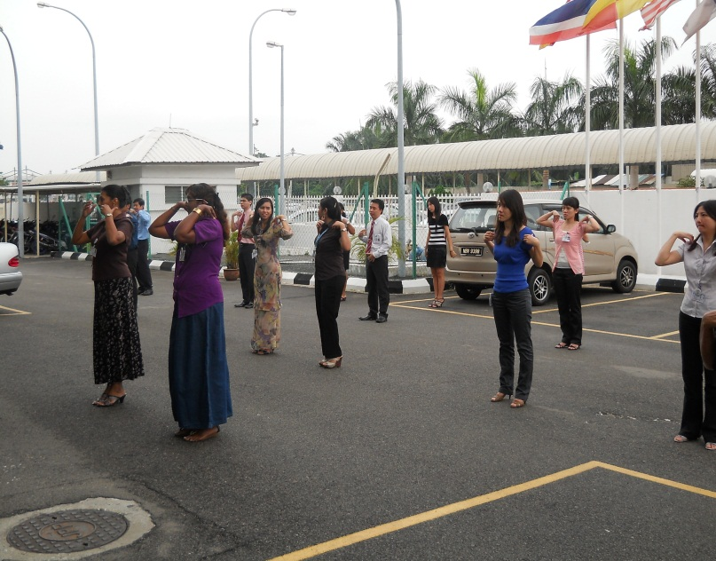
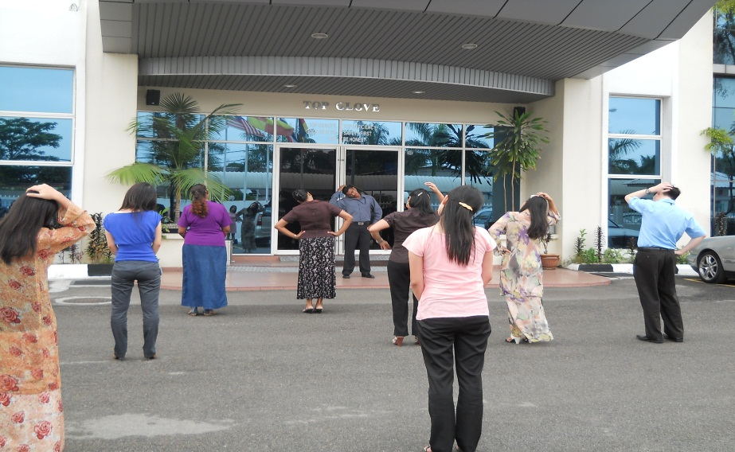
MORNING ASSEMBLY & MORNING EXERCISE
In order to “kick start” the day, employees are encourage to gather in front of their respective factory to perform 5 minutes warm up exercise before starting the morning assembly.
Every Monday, ‘Negaraku’ and Corporate Song are sang after the recitation Business Philosophy of the day.
On daily basis, after the morning exercise, employees will be assembled to listen the Business Philosophy of the day and then sing the Corporate Song

Slide 20


MENTOR-BUDDY SYSTEM
Mentor & Mentee System
Two (2) mentors will be assigned to coach and guide new employee during their entire career with the Company on the culture, work flow and the fundamentals of TG
Buddy System
Will be assigned to new employees for (3) months.
A colleague of the same department and not immediate supervisor.
Help new employees feels part of the organization

Slide 21
MERIT – DEMERIT SYSTEM
Employee will be rewarded with merit points when he/she received Reward Letter (RW) [depends on HOD discretion]. Example, participate in organizing Annual Dinner.
Employee will be penalize with demerit points when he/she received Training Letter (TL), Reminder Letter (RL) and Warning Letter (WL). Example, caught sleeping during working hours.

Slide 22

DWR, GLOVE WEIGHT & LABELING
DAILY WORK REPORT (DWR)
Employees are required to submit their DWR on daily basis to their HOT / HOD.
Format may be vary and employees have to check with Department /Factory / Secretary.
Employees are required to include TG business direction as the 1st item in the DWR.
GLOVE WEIGHT SPOT CHECK
At least once a month, the scheduled employees are to check the glove weight in their respective factory.
The respective HR officer of the Department or Factory will guide the employee on how to perform the check.

Slide 23
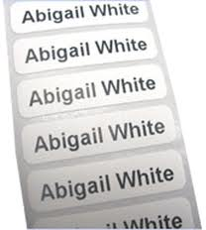
DWR, GLOVE WEIGHT & LABELING
LABELING
Labeling is essential practice in TG. All your belonging must be labeled with name, factory number, department and phone extension number for easy identification.
The Secretary or HR clerk will arrange the necessary labels for you.

Slide 24

SALARY INFORMATION
All new employees are required to have an account with CIMB.
Those with no CIMB account, they are entitled to take 2 hours o
off from work to open an account.
Salary is paid on the last day of every month.
Payroll cut-off is on 25th of the month.

Slide 25
WORKING HOURS
Monday – Friday Saturday
G1 : 8:00 AM to 5:30 PM G1 : 8:00 AM to 12:30 PM
G2 : 8:30 AM to 6:00 PM G2 : 8:30 AM to 1:00 PM
G3 : 9:00 AM to 6:30 PM G3 : 9:00 AM to 1:30 PM
Working Saturday
It depends on which department . Employees work on Saturday entitled to allowance.
Example:
Admin Department: at least one (1) Saturday a month.
Operation Department : alternate Saturdays.
Finger Scan (Clock in/out System)
When reporting to work and leaving the Company premises, even during lunch hour and for outside official work.

Slide 26
WORKING HOURS
Gate Pass
Gate Pass Form is filled when a staff moved from one factory to another or any other destination for work purposes.
Staffs have to fill in the Gate Pass Form on a monthly basis.
The form has to be verified and approved by HOD, and then submit to Accounts Department by 25th of the month.

Slide 27
TOP GLOVE SDN BHD (F2/9)
GATE PASS
Name
:
ABC
Department:
Human Resource
Badge No
:
1234567
Month :
July 2011
Time
HOD
Date
Out
In
Destination
Purpose
Sign
6/29/2011
07.39am
10.45am
Hostel
Hostel Spot check
7/7/2011
12.55pm
14.19pm
Mydin
Purchase basic items
7/8/2011
16.06pm
17.13pm
Male Hostel
Gotong Royong
7/11/2011
16.49pm
17.48pm
Meru
Purchase basic items

Slide 28
ATTENDANCE POLICY
Excellent attendance is expected from all TG’s employee. Employees will be given attendance allowance as per the following:
i. Full attendance : RM 50/month
ii. Late 1 or 2 times, UPL & forgot to finger scan : RM 25/month
iii. Late 3 to 5 times, UPL & forgot to finger scan : NIL
*Employee can check their attendance report through ERP system
Absenteeism
Employees must inform their HODs in case of EL / special leave.
Frequent absenteeism without leave or prior approval from HOD disciplinary action.
BOC if absent 2 days consecutively
without approval from HOD.

Slide 29
FLEXIBLE LUNCH HOUR
Staff is encouraged to go for lunch anytime between 12:00 PM to 2:00 PM. However, lunch hour is confined to 1 hour and MUST NOT exceed 2:00 PM.
Examples:
12:15 PM – 1:15 PM (Allowed)
12:45 PM – 1:45 PM (Allowed)
1: 05 PM – 2:05 PM (Not Allowed)
1: 30 PM – 2:30 PM (Not Allowed)
1.30 PM – 2:00 PM (Allowed)

Slide 30
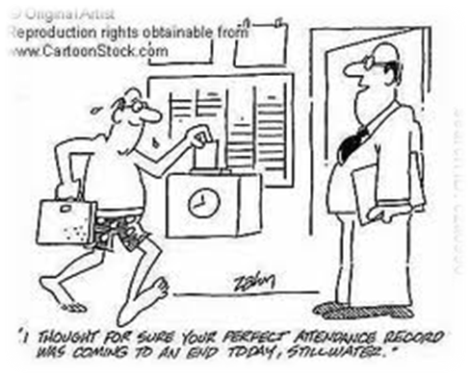
TARDINESS (LUNCH)
Penalty charges for being late after lunch:
Late 1 – 15 minutes = RM 0.50 penalty
Late > 15 minutes = RM 1.00 penalty
Late > 30 minutes = penalty computed based on basic salary
Example if late for 2 hour:
RM21.00 / (60 minutes x 8 hours / day) = RM 0.04 per minute
RM 0.04 x 120 minutes = RM 5.25

Slide 31
LEAVE ENTITLEMENT
Annual Leave
Compassionate Leave
Marriage Leave
Medical Leave
Examination Leave
Maternity Leave
Paternity Leave
Convocation Leave

Slide 32
ANNUAL LEAVE
Annual Leave (AL)
14 days of annual leave per annum.
Application for leave must be made using the e-leave with prior notice of minimum 3 days given to HOD.
entitled to 2 hours and 4 hours time off too.
Emergency Leave (EL) ( not > 5 times )
AL EL if employee taken the Leave BEFORE prior approval.
Training letter (TL) will be issued with 5 demerit points on the 6th EL in a year.
Upon returning to work, the concerned employee will have to fill in Leave / E –leave form and substantiate/ with necessary documents

Slide 33
LEAVE ENTITLEMENT
Compassionate Leave (death of spouse, children, parents, siblings, parent-in-law and grandparents).
Employee will be eligible for Compassionate Leave with basic pay subject to maximum of 8 working days per annum (subject to adequate notification)
In the case of;
Death of spouse, children, parents & parent-in-law = 2 days
Death of siblings and grandparents = 1 day
Documentary evidence shall be submitted to TG for verification within five (5) days of return to TG.

Slide 34

LEAVE ENTITLEMENT
Marriage Leave (2 Working Days)
Entitled for First (1st) Legal Marriage.
Leave can be taken either immediately before or after the date of the legal marriage.
Medical Leave (14 Working Days)
Employee shall be entitled to paid medical leave.
Medical certificate has to be from a certified Medical Practitioner (recommended from Company’s panel) and to be submitted within 48 hours.

Slide 35

LEAVE ENTITLEMENT
Examination Leave (4 Working Days)
Eligible for confirmed staff.
The course taken is relevant to his/her present work or beneficial to his/her present task with TG.
Not allowed to carry forward and repeat paper is not allowed.
Paternity Leave (2 Working Days)
Shall be granted immediately upon the birth of every child, up to 5 surviving children.
Birth of staff’s first legal wife’s children.
Copy of birth certificate of the child shall be produced upon returning to work.
Not allowed to carry forward.

Slide 36
LEAVE ENTITLEMENT
Convocation Leave ( 1 working day)
Staff who will be attending their own convocation is entitled to apply.
The course taken is relevant to his/her present work/beneficial to his/her present task with TG.
Minimum 3 days notification before going on leave
Staff must be able to produce substantiate documents to support leave application.
Cannot carry forward. No payment will be made in lieu when staff resigned.

Slide 37
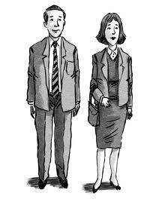
DRESS CODE
Work attire should complement an environment that reflects efficient, orderly, professionally operated organization.
The Company will provide uniforms as follows upon confirmation:
i. Female staff : 1 piece of blazer
ii. Male staff : 2 pieces of Short or Long Sleeve Shirt.
Casual business attire may be worn on Saturday of each week. However employees are not allowed to wear provocative attire.

Slide 38
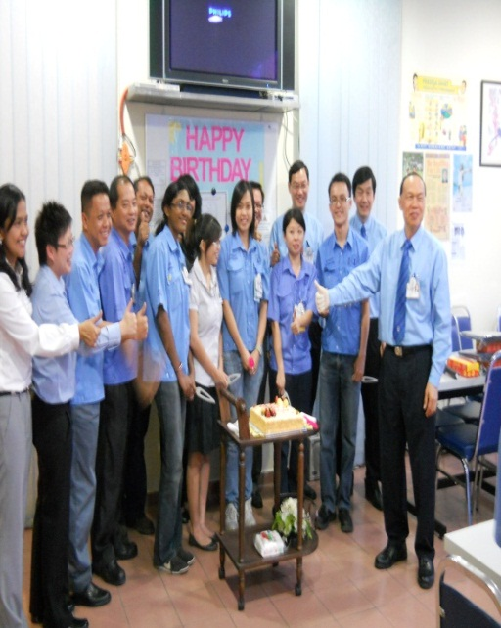

BENEFITS
BIRTHDAY LUNCH
Birthday lunch is organized monthly by respective factory.
Registration is required.
Vegetarian food is available (please state upon registration).
FRUIT DISTRIBUTION
Fruit distribution is on every Wednesday to promote healthy eating. Selection available: apple, orange or banana.

Slide 39

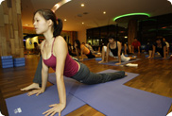
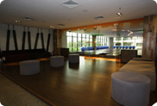
BENEFITS
STAFF FITNESS ACTIVITY SUBSIDY (BENEFIT)
Top Glove staff will be able to enjoy 50% or maximum of RM 50 subsidy (whichever is lower) for the following fitness activity:
Gym subscription fees
Swimming
Dancing
Yoga
Aerobics
Tai Chi / Zhi Kong
Meditation Classes

Slide 40
BENEFITS
STAFF FITNESS ACTIVITY SUBSIDY (BENEFIT)
Entitlement:
All staff will be able to enjoy this benefit.
Staff is required to submit original receipts with beneficiary to the respective factory Accounts to apply for this subsidy.
The original receipt must be from a centre/associate/society.
Staff is entitled to claim for one (1) fitness activity in a month.
The subsidy will strictly cover the subscription or lesson fees only, NOT any equipment / gear purchased.

Slide 41
BENEFITS
STAFF FITNESS ACTIVITY SUBSIDY (BENEFIT)
Procedure:
Chi Fitness Centro, Klang.
Top Glove will pay the total monthly subscription fees in advance and then the balance 50% will be deducted from the staff salary.
Staff who would like to register will have to inform Accounts in their respective factory.
Other Fitness Centre & Recreational Activities
Staff will have to submit the claim form attach with original receipt to Accounts in their respective factory.
If the staff currently enrolled or planned to enroll for activity that is not specified above, written submission must be made
directed to Ms. Chan (Accounts) or Ms. Gurmeet (HR).

Slide 42
MEDICAL BENEFIT & INSURANCE COVERAGE
MEDICAL & DENTAL COVERAGE
The company will pay for the medical & dental expenses not exceeding RM 200 each calendar year. Employee can visit the Company’s in-house Clinic or TG’s panel clinics.
If employee goes to non-panel? - written report must be made to HOD and submit Accounts. RM 2 will be deducted from the allowance if fail to submit report.
Able to get reimbursement if visit non-panel? YES. Also stated in the report.

Slide 43



MEDICAL BENEFIT & INSURANCE COVERAGE
ANNUAL HEALTH SCREENING
Employees entitled to annual blood test in which
partially is subsidized by the Company.
Consultation on the report are all
done in the Company itself.
INSURANCE COVERAGE (full time employees)
Hospital & Surgical Insurance
Tokio Marine Group.
Group Personal Accident Insurance Policy
Marsh Insurance Brokers (Malaysia) Sdn Bhd

Slide 44

ALLOWANCE & INCENTIVES
Travelling Allowance
Transfer / Assignment Allowance
Attendance Incentives
Saturday Working Allowance

Slide 45



SPORTS CLUB
Employees are entitled to participate in any events that are organized by TG’s Sports Club Committee Members.
Tournaments are usually organized once a month.
Badminton is played every Monday, Wednesday and Friday each week.
It is held at the Setia Alam Badminton Court from 6:30 PM to 9:00 PM.

Slide 46

TG’S POLICIES & STANDARDS
NO SMOKING
Employees are strictly NOT ALLOWED to smoke.
‘No Smoking Declaration’ form has to be signed by all newly employed staffs.
SECURITY CHECKS
Security Guards are authorized to check an employees entering and leaving the Company’s premises.
COMPANY GOODS & PROPERTY
Any Company’s goods or property taken out of the Company’s premises must be accompanied by DN / DO which must be declared to the Security Guards on duty.
No Company goods or property are allowed to be taken / transport out from the Company on Sundays or Public Holiday without prior approval from the Management.

Slide 47
TG’S POLICIES & STANDARDS
CONFIDENTIALITY
Employees are strictly prohibited to disclose and shall
endeavor to prevent disclosure of any trade secret, knowledge or information of a confidential nature.
ENFORCEMENT OF CORPORATE CULTURE
Employees are advised to refrain from accepting gifts of any forms of inducements from suppliers or third (3rd) parties in consideration for granting them PO or contract.
PHOTOGRAPHS / VIDEO RECORDING
Approval from the Company is required before any photographs or video recording of the factory premises can be made.

Slide 48

TG’S POLICIES & STANDARDS
PERSONAL PHONE CALLS
Should be made within 10 minutes and less. It is for important and urgent matters only.
Call to other factory : 100 (tone) F# (tone) Ext.
External calls: 9 (tone) number.
VISITORS
Employees are not allowed to have visitors (i.e. friends and relatives) without prior permission from the Company.
Any official visitors or suppliers must be accompanied at all time while they are in the Company premise.

Slide 49
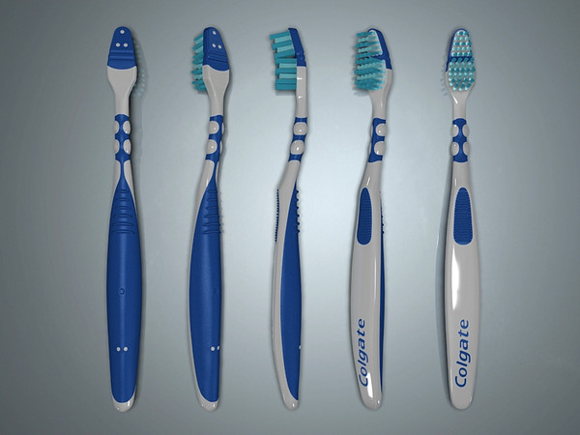

TG’S POLICIES & STANDARDS
CLEANLINESS
-Workstation has to be kept clean and organized at all times
-Pick a rubbish day campaign
TOOTH BRUSH & TOOTH PASTE
Tooth brush & tooth paste are subsidized completely for this first time only.
Brush 8 hours a day or 3 times a day

Slide 50

TG’S POLICIES & STANDARDS
MEALS & Tea Breaks
Tea-breaks for 15 minutes.
Meals have to be taken in the canteen,
cafeteria and pantry
No polystyrene allowed in canteen and factory area.

Slide 51
TG COMPUTER POLICY
USER RESPONSIBILITY
Employee is responsible for the proper use, care & maintenance of the computer system.
UNAUTHORIZED & ILLEGAL SOFTWARE
Employees are not allowed to install any software of any kind without prior approval from IT department is NOT ALLOWED.
COMPUTER VIRUS & COMPUTER GAMES
Do not open unexpected or suspicious e-mail attachment, even from co-workers.
PC games or entertainment software is not to be used or loaded into the PC.

Slide 52

GRIEVANCE PROCEDURE
The grievance procedure is available for expressing legitimate dissatisfaction without fear or criticism.
This is to ensure employee received fair & equitable treatment.
However, before filing for grievance, try to resolve the situation with informal discussion with your superior.
Formal grievances can be filed in return to HR department or TGPAC.
Fill up Complaint Form and place them in the Guard House Box.

Slide 53





Top Glove Corporation Berhad
Thank you
www.topglove.com.my
invest@topglove.com.my
+603 5022 2110

